Slide 1

Introduction to Artificial Intelligence
Week 1: What, Why, and Where?
Lecturer: Awara Bakhtiyar Rasool January 19, 2026
Salahaddin University-Erbil
College of Economics and Management
Lecturer: Awara Bakhtiyar Rasool
—
January 19, 2026

Slide 2
Defining AI
Definition
Artificial Intelligence (AI) is the creation of machines that can think, learn, and make decisions like humans.
It enables computers to perform tasks that typically require human intelligence, such as:
Visual Perception (Seeing like a human)
Speech Recognition (Hearing like a human)
Decision-making (Thinking like a human)
Translation (Communicating like a human)
Lecturer: Awara Bakhtiyar Rasool
—
January 19, 2026

Slide 3
Types of Software
There are two fundamental categories of software:
1. Non-Intelligent Software
2. Intelligent Software (AI)
Rule-based: Follows explicit ”If-Then” rules.
Scripted: Does exactly what it is told. No learning.
Example: A calculator app. It multiplies perfectly but doesn’t ”understand” math.
Senses: Gathers data (input).
Reasons & Learns: Finds patterns/adapts.
Decides: Chooses actions autonomously.
Example: Spotify recommendation engine.
Lecturer: Awara Bakhtiyar Rasool
—
January 19, 2026

Slide 4
The Three Categories of AI
Weak AI
Strong AI (AGI)
Super AI
Narrow Task (Today)
Human Level (Future?)
Super Natural (Theoretical)
Lecturer: Awara Bakhtiyar Rasool
—
January 19, 2026

Slide 5
1. Weak AI (Narrow AI)
Definition
Designed and trained to perform one specific task. It operates within a limited range and lacks consciousness.
Examples (All Current AI):
Virtual Assistants: Siri, Alexa.
Recommenders: Netflix, Spotify.
Self-Driving Cars: Great at driving, but can’t play Chess.
ChatGPT: Great at text, but doesn’t ”know” what it’s saying.
Status: Exists Today.
Lecturer: Awara Bakhtiyar Rasool
—
January 19, 2026

Slide 6
2. Strong AI (General AI / AGI)
Definition
A theoretical form of AI that possesses human-level intelligence. It can understand, learn, and apply knowledge to any problem.
Would have consciousness, empathy, and self-awareness.
Indistinguishable from a human mind.
Status: Does Not Exist Yet.
Lecturer: Awara Bakhtiyar Rasool
—
January 19, 2026

Slide 7
3. Super AI (Superintelligence)
Definition
A theoretical form of AI that surpasses human intelligence in every aspect—creativity, problem-solving, and social skills.
Potential Capabilities:
Solving global crises (Climate Change, Poverty).
Eradicating diseases.
Unlocking secrets of the universe.
Status: Theoretical Future.
Lecturer: Awara Bakhtiyar Rasool
—
January 19, 2026

Slide 8
Foundations of AI

Slide 9
Foundations of AI: Data Sets
Data is the fuel for AI. The lifecycle of data includes:
2. Pro- cessing
(Cleaning)
4. Man- agement (Storing)
1. Collection (Gathering)
3. Analysis (Patterns)
Business Context
Collecting customer feedback → Cleaning it → Finding trends → Storing for future strategy.
Lecturer: Awara Bakhtiyar Rasool
—
January 19, 2026

Slide 10
Foundations of AI: Mathematics
AI is built on a strong mathematical foundation.
Key Mathematical Fields
Statistics: Handling uncertainty and data trends.
Probability: Predicting likelihood of events.
Calculus: Optimization (changing rates).
Linear Algebra: Handling multi-dimensional data arrays.
Lecturer: Awara Bakhtiyar Rasool
—
January 19, 2026

Slide 11
Foundations of AI: Computer Science
To implement the math, we need Computer Science tools.
Core CS Concepts
Programming: Writing instructions (Python, C++).
Data Structures: Organizing data efficiently (Trees, Graphs).
Algorithms: Step-by-step procedures for calculation.
Software Development: Building robust systems.
Lecturer: Awara Bakhtiyar Rasool
—
January 19, 2026

Slide 12
History of AI

Slide 13
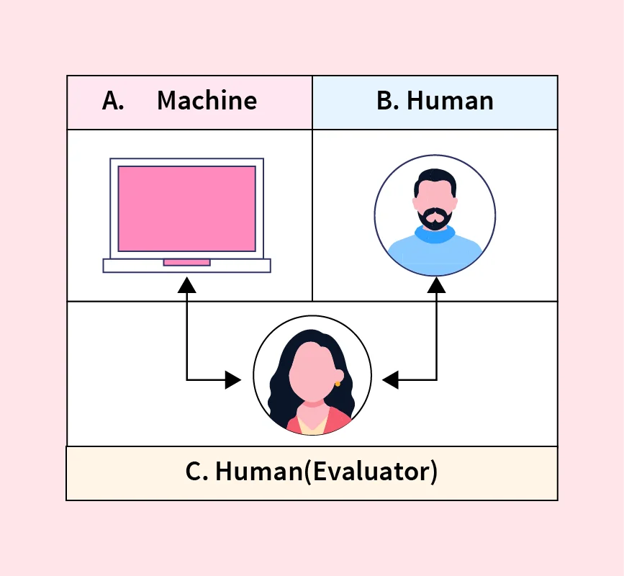
The Turing Test (1950)
Can machines think?
Proposed by Alan Turing.
A test to see if a computer can fool a human into thinking it is also human.
If the human judge cannot tell which is the machine, the machine passes.

Slide 14
History of AI: Phase 1 (1950s) - The Birth
Theoretical Foundation
1956: The Name ”AI”
At a famous meeting (Dartmouth Conference), scientists officially created the field of ”Artificial Intelligence.”

Slide 15
History of AI: Phase 2 (1960s) - Early Hype
The First Programs
Researchers started building systems that could ”talk” and ”move.”
Key Milestones:
  ELIZA: The first Chatbot.
  Shakey: The first Mobile Robot.

Slide 16
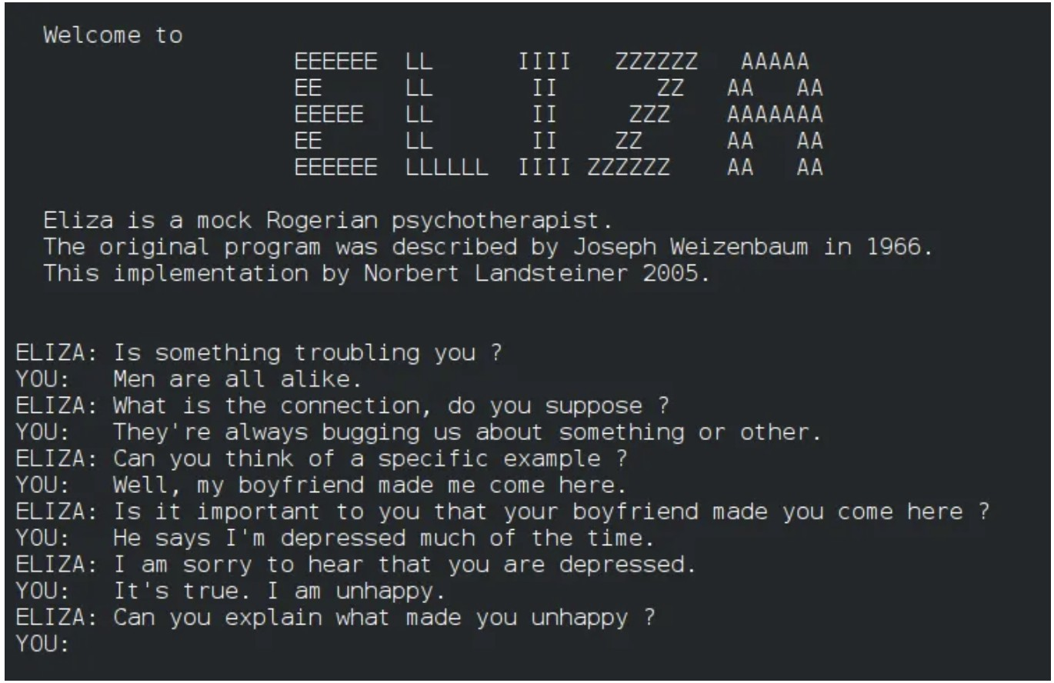
ELIZA (1964): The First Chatbot
Created by Joseph Weizenbaum at MIT.
What it did: Pretended to be a therapist.
How it worked: It looked for keywords. If you said ”I feel sad”, it simply asked ”Why do you feel sad?”.
Impact: People thought it was real, even though it didn’t understand anything.

Slide 17
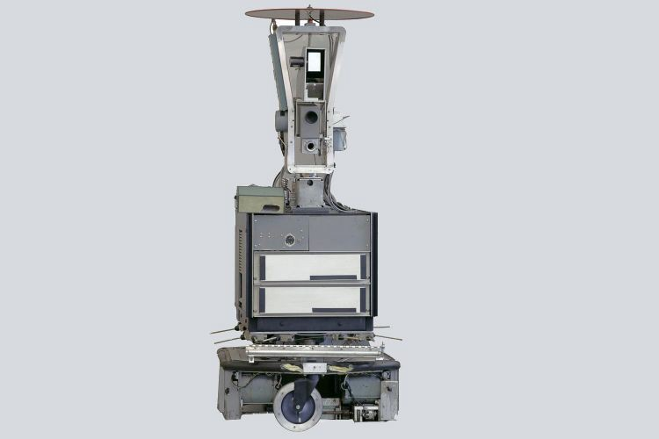
Shakey the Robot (1966)
Developed at SRI International.
The first robot that could move and think.
Capabilities: It could look at a room and plan how to move across it.
Limit: It was very slow (”shook” while thinking).
Legacy: The ”Grandfather” of self-driving cars.
Lecturer: Awara Bakhtiyar Rasool
—
January 19, 2026

Slide 18
History of AI: Phase 3 (1990s) - Modern Era
Computers Get Smarter
AI started solving specific, complex problems.
Key Milestones:
  Deep Blue: Beating the World Chess Champion.
  Google Search: Organizing the world’s information.
Lecturer: Awara Bakhtiyar Rasool
—
January 19, 2026

Slide 19
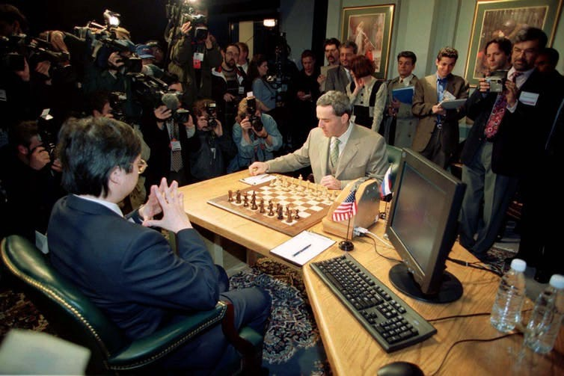
Deep Blue vs. Kasparov (1997)
The Match: IBM’s Deep Blue played against Garry Kasparov (World Champion).
The Result: Deep Blue won.
Significance: It was the first time a machine defeated a reigning world champion in a complex game.
Method: ”Brute Force” search (calculating 200 million positions per second).
Lecturer: Awara Bakhtiyar Rasool
—
January 19, 2026

Slide 20
History of AI: Phase 4 (2010s+) - The Revolution
Deep Learning Takes Over
2012: AlexNet: Computers suddenly got VERY good at recognizing images (Cats vs. Dogs).
2022: ChatGPT: AI learned to write poetry, code, and essays like a human.
Lecturer: Awara Bakhtiyar Rasool
—
January 19, 2026

Slide 21
The Recipe for Revolution
It wasn’t magic. It was the convergence of three factors:
1. Big Data
2. Hardware
3. Algorithms
Explosion of data from social media and sen- sors.
Faster Computers (GPUs). Gaming tech powering AI.
Smarter Math. Better ways to train Deep Net- works.
Lecturer: Awara Bakhtiyar Rasool
—
January 19, 2026

Slide 22
AI Ethics: Why it Matters
Reflection
”With great power comes great responsibility.”
As future managers, you must understand the risks:
Bias: If we train AI on bad data, it makes unfair decisions (e.g., rejecting loans for minorities).
Privacy: Who owns the data? (Your face, your clicks).
Deepfakes: AI generated fake videos/audio. How do we trust what we see?
Lecturer: Awara Bakhtiyar Rasool
—
January 19, 2026

Slide 23
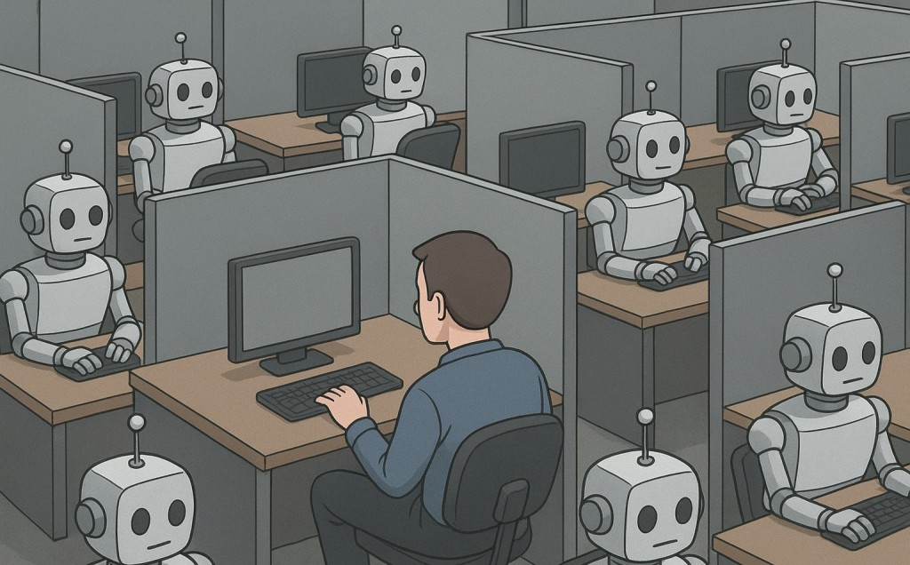
AI will replace all humans.
Lecturer: Awara Bakhtiyar Rasool
—
January 19, 2026

Slide 24
Myths vs. Reality
REALITY
MYTH
”AI will replace humans who don’t use AI.”
”AI will replace all humans.”
The Goal: AI is a tool (like Excel or specific software), not a replacement for human creativity and empathy.
Lecturer: Awara Bakhtiyar Rasool
—
January 19, 2026

Slide 25
AI Disciplines

Slide 26
1. Machine Learning (ML)
Definition
Focuses on developing algorithms that enable computers to learn from and make pre- dictions based on data.
Business Example
Prediction: Predicting numbers (Predicting house prices based on size).

Slide 27
2. Natural Language Processing (NLP)
Definition
Involves the interaction between computers and human language.
Speech Recognition: Siri, Alexa.
Language Translation: Google Translate (Kurdish ↔ English).
Sentiment Analysis: Understanding customer emotions in reviews.
Text Generation: Creating essays, code, or emails (ChatGPT).

Slide 28
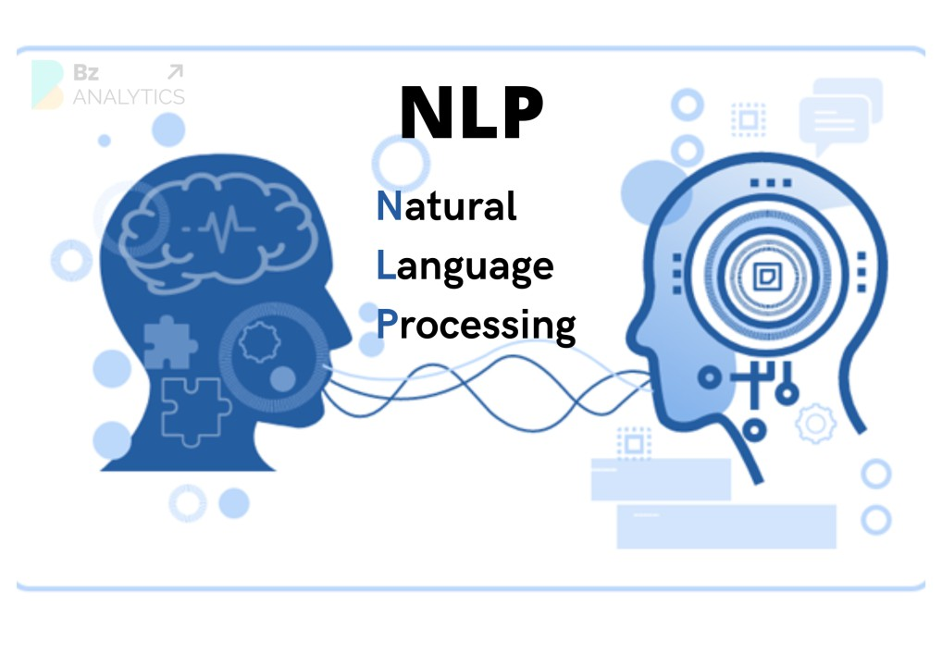
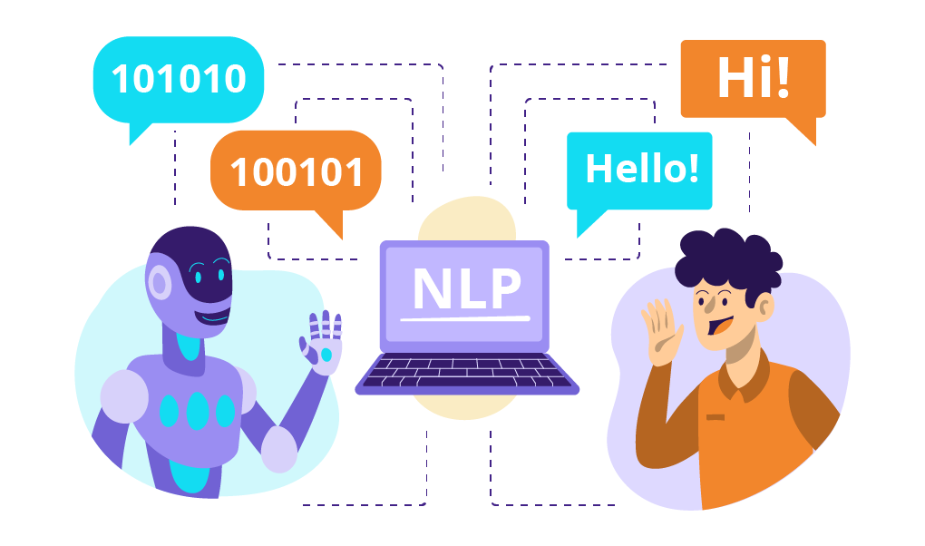
NLP

Slide 29
3. Computer Vision
Definition
Deals with how computers gain high-level understanding from digital images or videos.
Object Recognition: Identifying products on a shelf.
Image Classification: Sorting photos (Cat vs Dog).
Business Use: Quality control in factories (spotting defects).
Generation: Creating new images or videos (Midjourney, Sora).

Slide 30
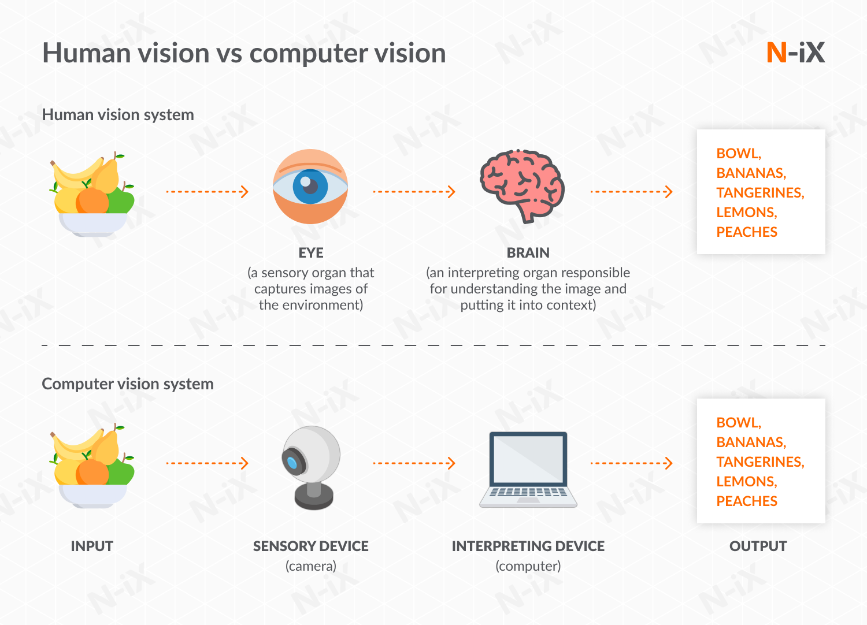
Computer Vision

Slide 31
4. Robotics
Definition
Combines AI with mechanical engineering to create robots that perform tasks.
Autonomous: Robots that work without human help.
Assistive: Robots that help humans lift heavy objects.

Slide 32
5. Expert Systems
Definition
Systems that emulate the decision-making ability of a human expert.
Uses a knowledge base of rules (”If X then Y”).
Example: Medical diagnosis systems or Loan Approval systems in banking.

Slide 33
6. Neural Networks & Deep Learning
Definition
Algorithms inspired by the structure of the human brain.
Particularly effective for complex tasks like image and speech recognition.
”Deep Learning” implies many layers of these neural networks.

Slide 34
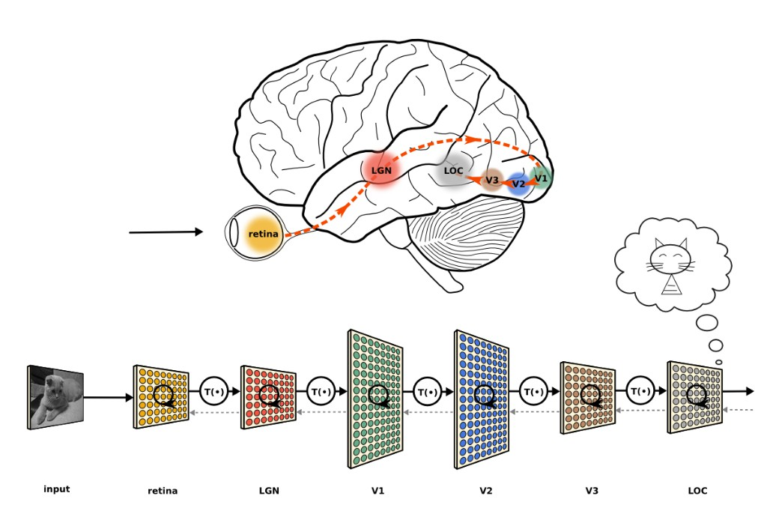
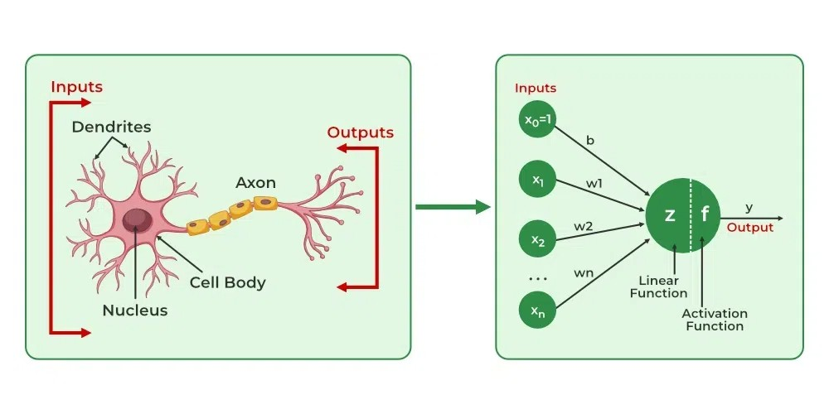
Neural Network Visualization
Architecture
Bio-Inspiration

Slide 35
Type 1: Supervised Learning
”Learning with a Teacher”
The computer learns from labeled data. We give it the question and the answer key.
How it works:
Input: Image of an apple.
Label: ”This is an apple.”
The model learns to link the image to the name.
Examples
Spam classification (Spam/Not Spam)
Face Recognition
Medical Diagnosis

Slide 36
Example: Spam Email Filtering
Traditional Approach
AI Approach (Supervised)
Problem: Manually defining rules.
”If email contains ’Free Money’, delete it.”
Failure: Spammers change ”Free Money” to ”Fr33 M0ney” and the rule fails.
Solution: Learning from data.
Show AI 1,000,000 spam emails and 1,000,000 normal emails.
AI finds the patterns itself (words, sender, time).
Adapts automatically to new tricks.

Slide 37
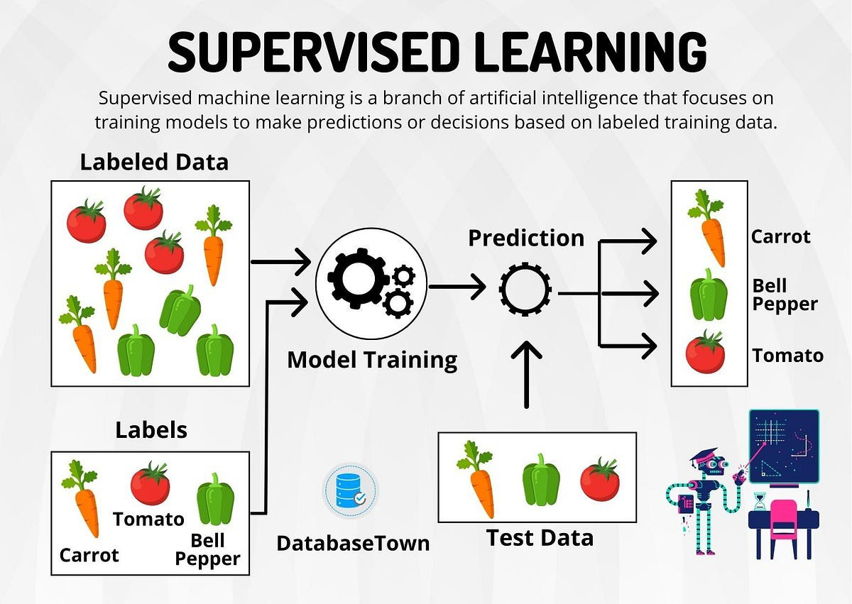

Slide 38
Type 2: Unsupervised Learning
”Learning without a Teacher”
The computer learns from unlabeled data. It must find hidden patterns or structures on its own.
Examples
How it works:
Input: A database of customer purchases.
No labels.
The model groups similar customers together.
Customer segmentation (Marketing)
Product recommendations
Anomaly detection (Fraud)
Lecturer: Awara Bakhtiyar Rasool
—
January 19, 2026
35 / 45

Slide 39
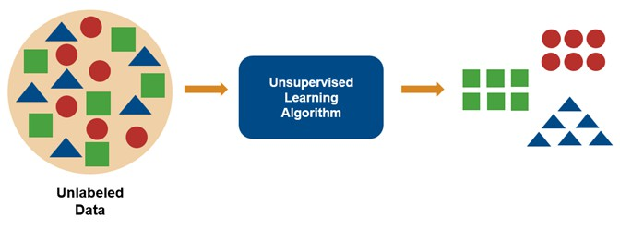

Slide 40
Type 3: Reinforcement Learning
”Learning by Trial & Error”
The computer learns by interacting with an environment and receiving rewards or pun- ishments.
How it works:
Agent takes an action (e.g., moves chess piece).
Environment gives specific feedback (Win = +10, Lose = -10).
Agent optimizes to get max reward.
Examples
Playing Chess/AlphaGo
Training Robots to walk
Self-driving cars
Lecturer: Awara Bakhtiyar Rasool
—
January 19, 2026

Slide 41
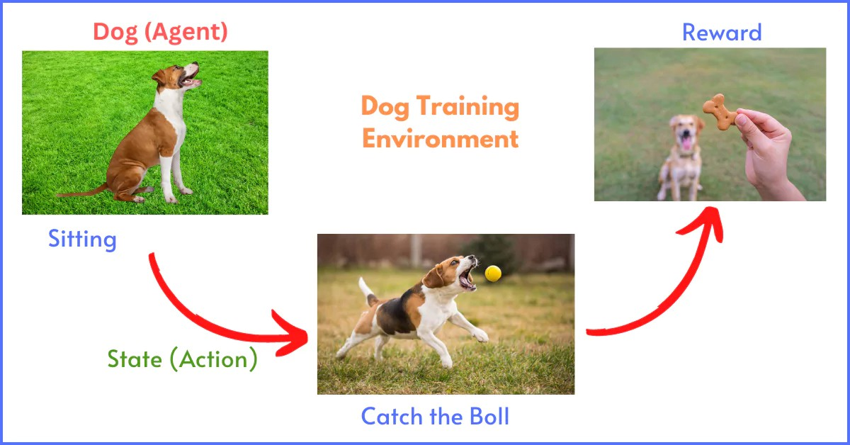
Reinforcement Learning Example
Lecturer: Awara Bakhtiyar Rasool
—
January 19, 2026

Slide 42
AI Applications

Slide 43
Engineering Applications Overview
AI transforms every engineering discipline:
Mechanical
Electrical
Civil
Chemical
Architecture
Aerospace

Slide 44
Misconceptions vs. Reality
(Discussion)

Slide 45
Misconception 1: AI Understands Meaning
The Myth
”AI understands words, images, and concepts just like a human does.”
The Reality
AI does not truly understand meaning.
It recognizes patterns and statistical relationships in data.
It lacks consciousness, awareness, or comprehension.
Example: Chatbots (like GPT) generate coherent text based on probability, not because they ”know” what they are saying.

Slide 46
Misconception 2: AI Has Emotions
The Myth
”AI can feel happy, sad, or empathetic.”
The Reality
AI does not have feelings or consciousness.
Emotional responses (”I’m sorry to hear that”) are purely programmed simulations.
Key Point: A robot programmed to smile is executing code, not experiencing happiness.
Lecturer: Awara Bakhtiyar Rasool
—
January 19, 2026

Slide 47
Misconception 3: AI Can Do Everything
The Myth
”If a machine is smart, it can solve any problem.”
The Reality: Narrow AI
Most AI today is Narrow AI—designed for one specific task.
Knowledge generally does not transfer without retraining.
Example: A Chess champion AI cannot drive a car. A Face Recognition system cannot compose music.
Lecturer: Awara Bakhtiyar Rasool
—
January 19, 2026
42 / 45

Slide 48
Assumptions Behind AI Research
AI isn’t magic; it’s math.
The Core Assumption
”Intelligence can be represented mathematically.”
Meaning: Reasoning, learning, and decision-making can be expressed as algorithms and models.
Why it matters: We need to translate ”intelligence” into code that a computer can execute.
If we couldn’t model it mathematically, we couldn’t build AI.
Lecturer: Awara Bakhtiyar Rasool
—
January 19, 2026

Slide 49
Why These Misconceptions Matter
Expectations vs. Reality: Students shouldn’t overestimate what AI can do (leads to disappointment).
Ethical Decisions: Misunderstanding AI leads to misplaced trust (e.g., trusting AI for moral judgment).
Design Perspective: Understanding limitations helps us design better systems.
Reflection
Analogy: Think of AI like a car. It’s great at transport, but it can’t cook dinner. It’s a tool with a specific purpose.
Lecturer: Awara Bakhtiyar Rasool
—
January 19, 2026

Slide 50
Thank You! Questions?
Lecturer: Awara Bakhtiyar Rasool
—
January 19, 2026

